Slide 1

USC Staff Meeting
1/14/2026
9:00pm
C107

Slide 2
Agenda
Activity
Updates
Committee Introductions
RA Connection Challenge
Housekeeping
For the good of the order

Slide 3
Activity: Rose, Thorn, Bud
How it works: Each person shares:
Rose = something positive that happened recently
Thorn = A challenge you're facing
Bud = Something you're looking forward to

Slide 4
Updates
Student Government
Community Education – Jocy
Movies, Music, and More (Residence Life Libraries)
Residence Life Advisory Council (RLAC)

Slide 5
Committees
Event Planning Committee
Leads the planning for center events (everyone is still expected to go), advertising, media
Bulletin Board Committee
Creates a center BB for each month based on an educational topic that other RAs can use, keeps track of inventory for Resource Room
Leadership and Development Committee
Awards (Team Member, Bulletin Board, Duty Pic of the month, etc.), Superlatives, Shout-outs, Of the Months (OTMs), plans leadership sessions for meetings

Slide 6
RA Connect Challenge
Objective: Staff compete to have the most meaningful interactions with residents during the challenge period.
Rules:
Ends January 28
How to Earn Points:
Quick Chat: Say hello and learn one new fact about a resident (1 point).
Meaningful Conversation: Spend at least 5 minutes talking about classes, hobbies, or life updates (3 points).
Event Attendance: Resident attends an RA-hosted event (5 points per resident).
Creative Interaction: Do something unique (e.g., play a game, help with a task) (bonus 2 points).

Slide 7
RA Connect Challenge, Cont'd
Log Interactions in Excel Doc in Teams
Interactions must be genuine (no repeating the same resident for points unless it’s a different type of interaction)
Prizes:
Top RA: Dinner of your choice paid for my Michael or give a primary duty shift to Michael
Runner-Up: Michael will do one of your bulletin boards

Slide 8
Housekeeping Items
Encourage your new residents to do roommate agreements!
Checking Cedar during duty
Potential staff member vacancy and
Bulletin Board submission pictures will go into the Bulletin Board channel in the staff Teams
Talk with your returning peers and let Michael know roommate/building preferences
Simone-Mone't, Taryn, Lamond, Natalie, Olivia, Marie, Deborah, Kevin, Ellie, Khushi, Olu, Quinlan
Honors Community?
Moving to a modified structure
Thoughts on training?
MLK DAY (1/19):
Center Desk is open by Lynda and I are OOO. Duty will be needed during the day
Extra set of rounds for 1/19 after game

Slide 9
Upcoming Dates
Next timelog due: THIS SUNDAY, 1/18/2026
Next bulletin board due: MONDAY, 2/2/2026
Next Events:
Jocy's MLK Event, THIS FRIDAY, 1/19

Slide 10
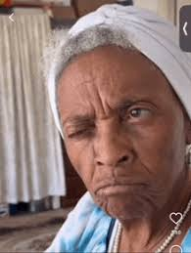
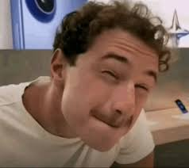
Anything for the good of the order?

